Slide 1
CS 419: Production Rendering
Eric Shaffer Some Slides Adapted From Pat Hanrahan, Stanford University CS345b Image Synthesis

Slide 2
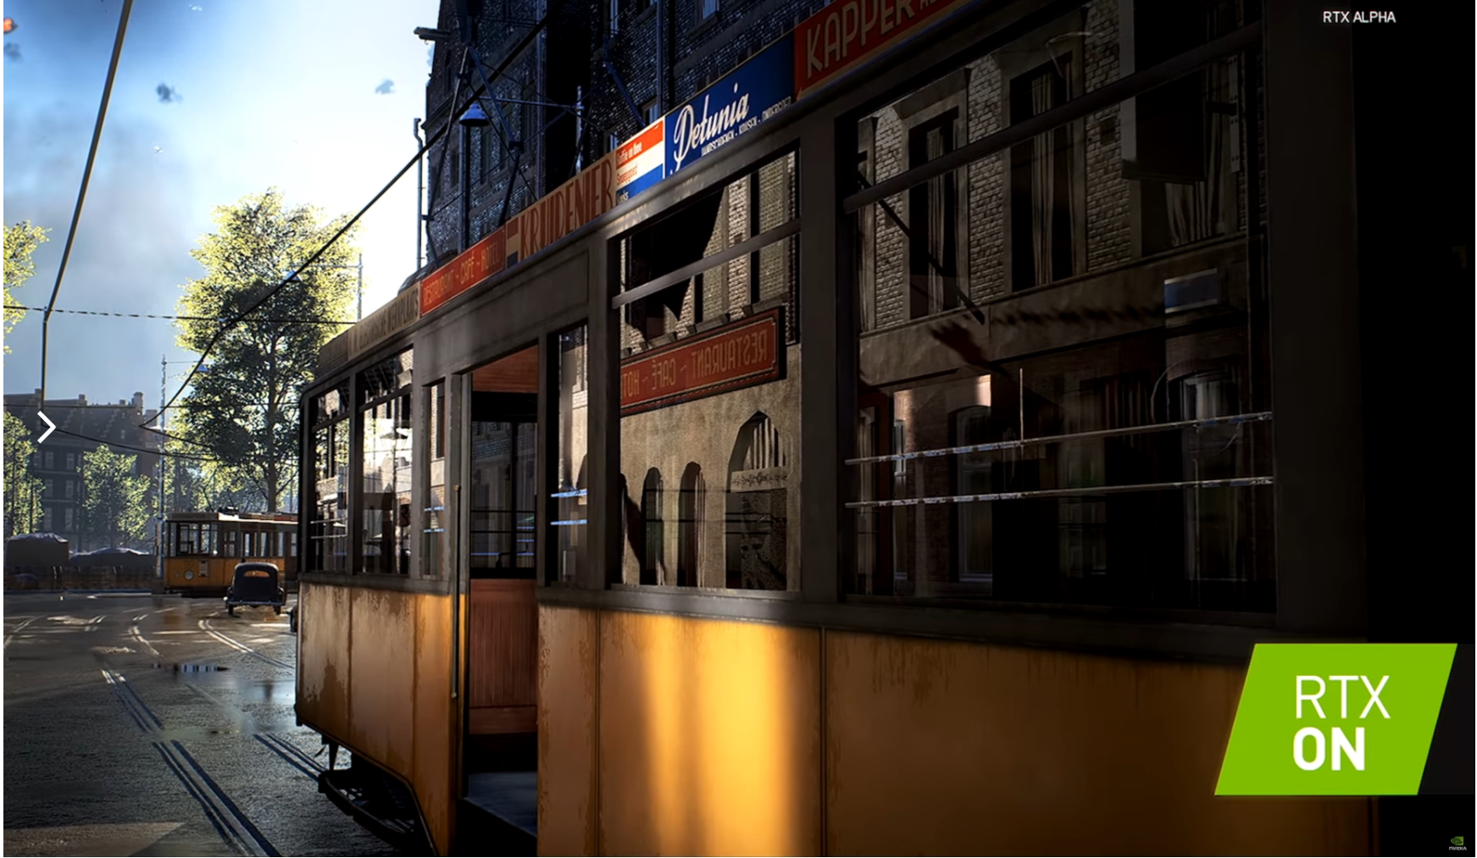
What is Production CG?
In the past…it meant more realistic rendering than rasterization
Complex lighting effects like caustics and subsurface light transport...
Often, but not always, achieved by ray-tracing
But…this past year…technology reached the point where many effects regarded as Production CG can now be achieved in real-time.
This is a big deal….
Can anyone name some non-rasterization rendering techniques that aren’t ray-tracing?

Slide 3

Unreal Engine Demo

Slide 4
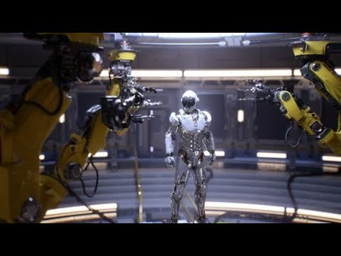
…and another

Slide 5
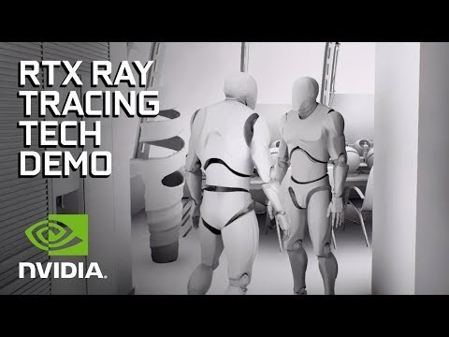
…and another

Slide 6
Some Goals for the Course
You will learn about the terminology and techniques you just saw
For example…AO…denoising…path tracing….etc.
We learn how ray-tracing works by implementing a ray tracer
CPU-based
Preferably from scratch…meaning you write almost all the code yourself
…but I’m open to other possibilities
…but keep in mind that the goal is learning
We will finish up the semester by looking at some current stuff
For example….HDR…procedural generation…real-time ray-tracing

Slide 7
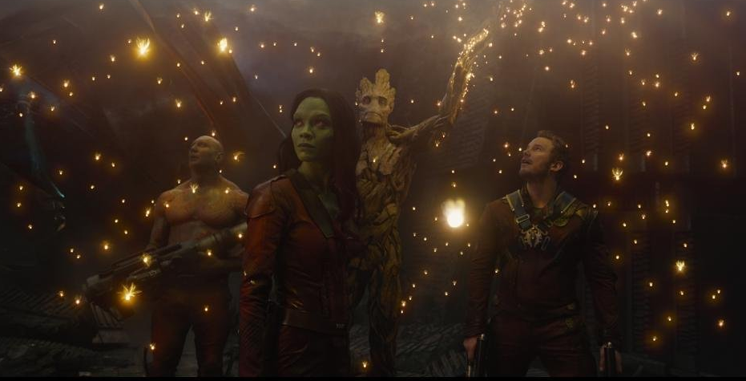
What drives CG technology
Movie Industry

Slide 8
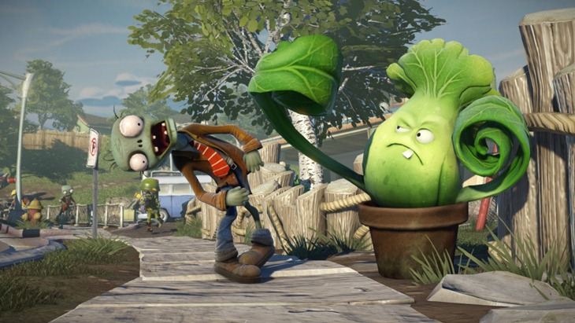
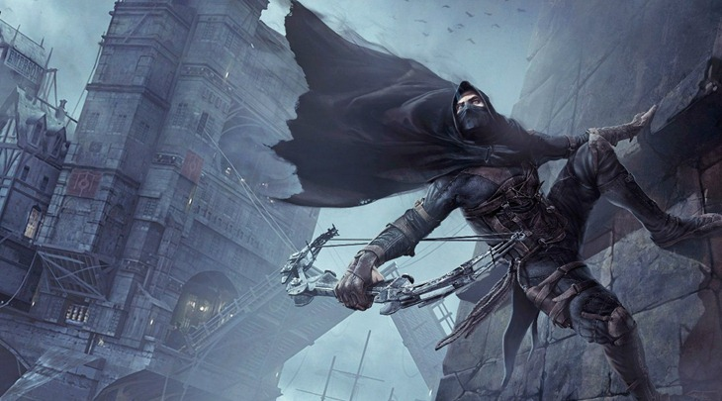
What drives CG technology
Video Game Industry
Higher revenue than movies ($108B in 2017)

Slide 9
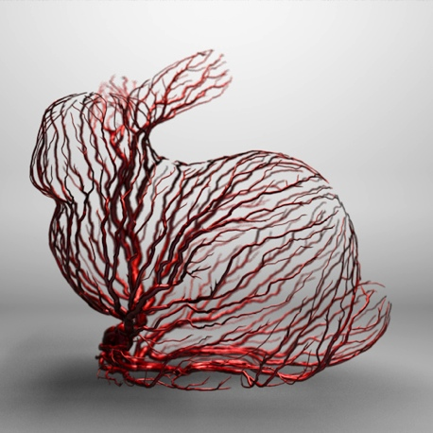
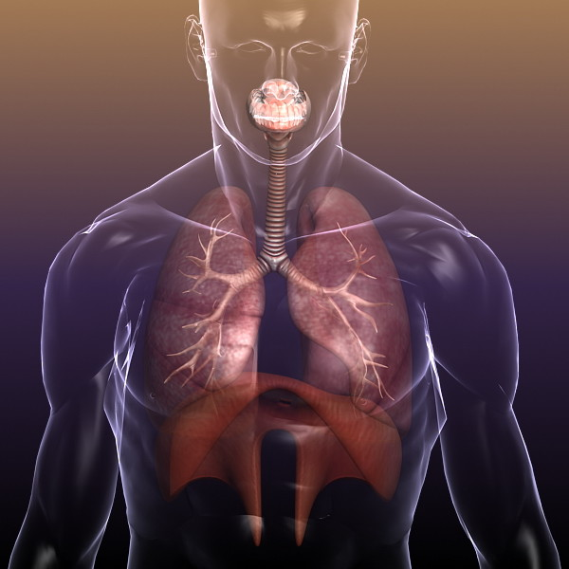
What drives CG technology
Medical Imaging and Scientific Visualization
Imaging one of the biggest advances in medicine
Sci Vis allows people to see previously hidden phenomena

Slide 10
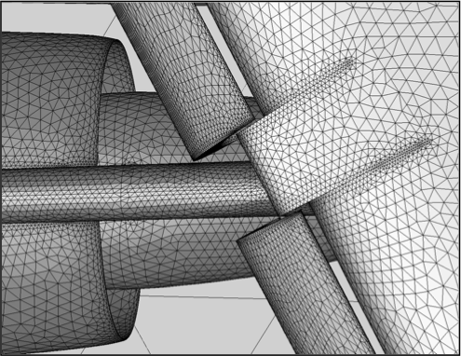
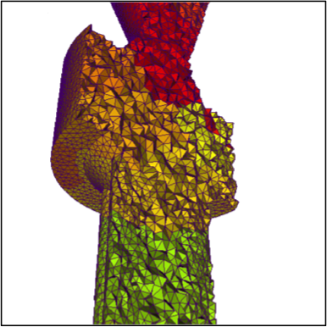
What drives CG technology
Computer Aided Design
Engineering, Architecture, the Maker movement

Slide 11
General Goals of Rendering
Increase quality
More accurate modeling of the physics of light
Better models of materials
Reduce time
More efficient algorithms (numerical or otherwise)
Better data structures
Parallelism

Slide 12
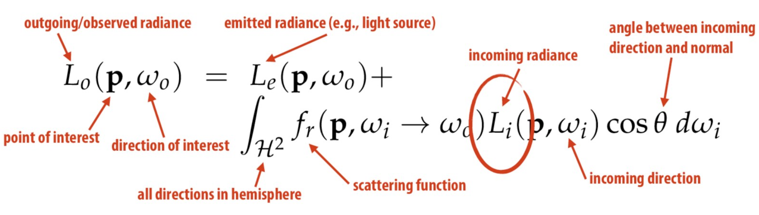
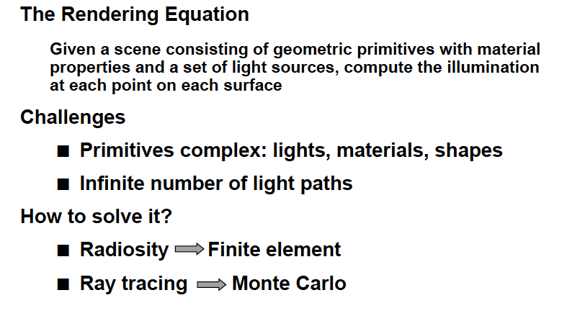
Rendering through Lighting Simulation
The Rendering Equation
Given a scene consisting of primitives with material properties and a set of light sources, compute the illumination at each point on each surface

Slide 13
Rendering through Lighting Simulation
Challenges
Primitives are complex: lights, materials, shapes
Infinite number of light paths
How to solve it?
Radiosity → Finite Element
Ray Tracing → Monte Carlo Method

Slide 14
Photorealistic Rendering Effects
Diffuse Reflection
Specular Reflection
Point and Area Lights
Hard and Soft Shadows
Transparency and Translucency
Mirroring
Materials (skin,etc.)
Atmospheric Effects
And more….

Slide 15
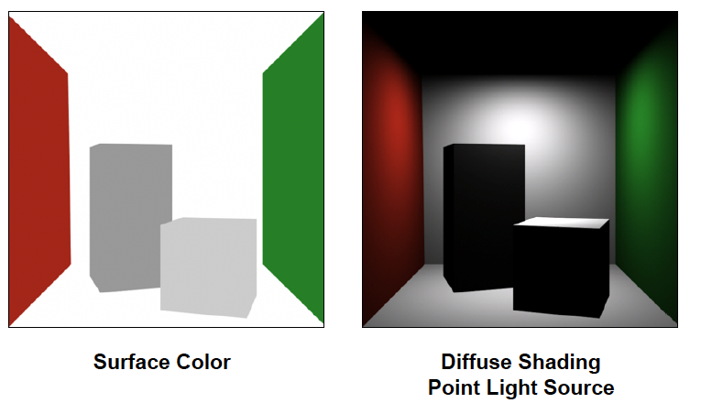
Lighting: Diffuse Reflection

Slide 16
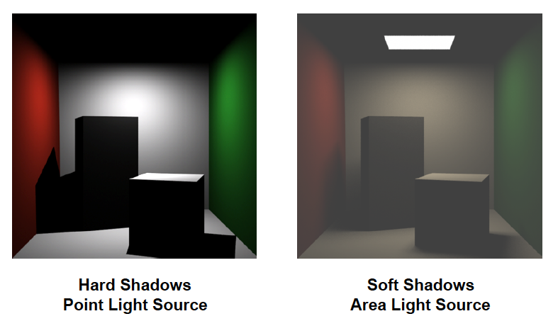
Lighting: Soft Shadows

Slide 17
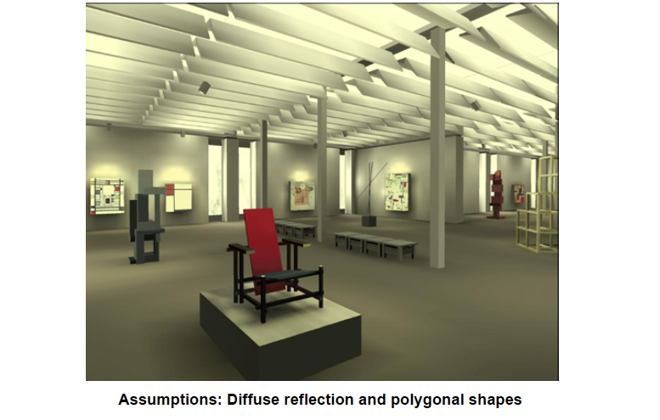
Radiosity

Slide 18
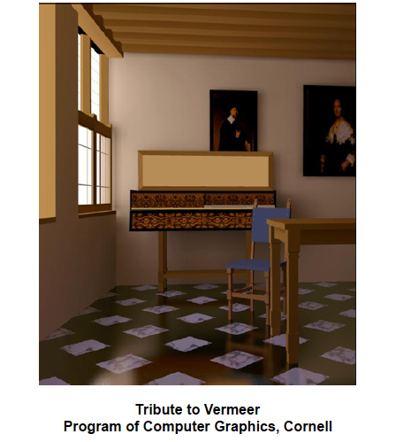
Diffuse and Glossy

Slide 19
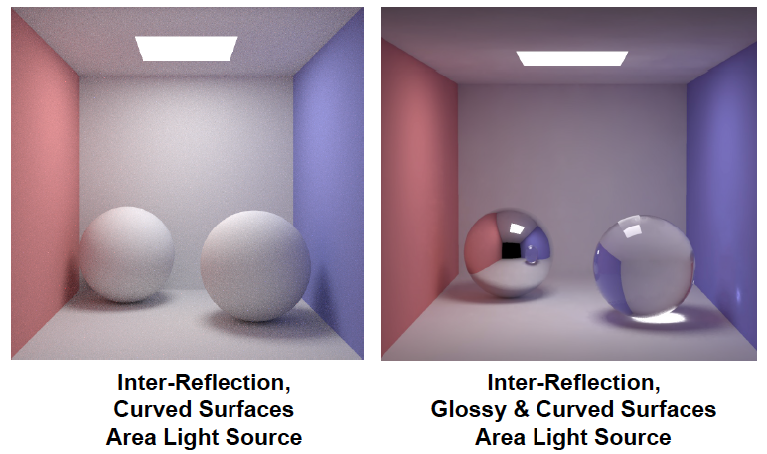
Glossy and Curved Surfaces

Slide 20
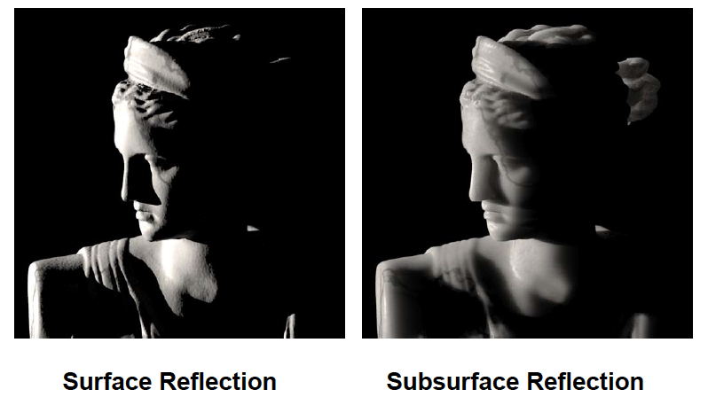
Tranlucency

Slide 21
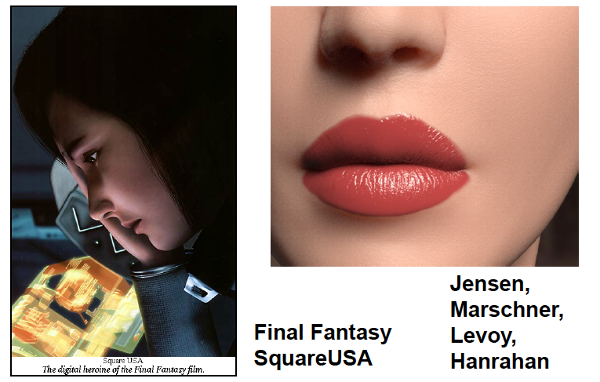
Skin and Faces

Slide 22
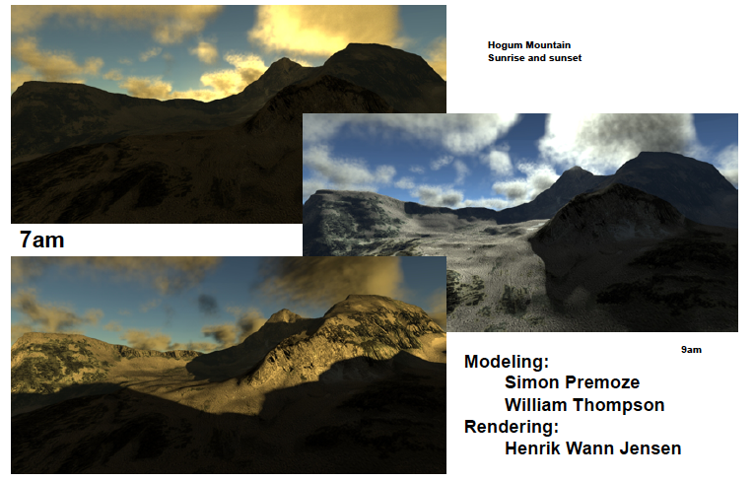
Clouds and Atmospheric Phonomena

Slide 23
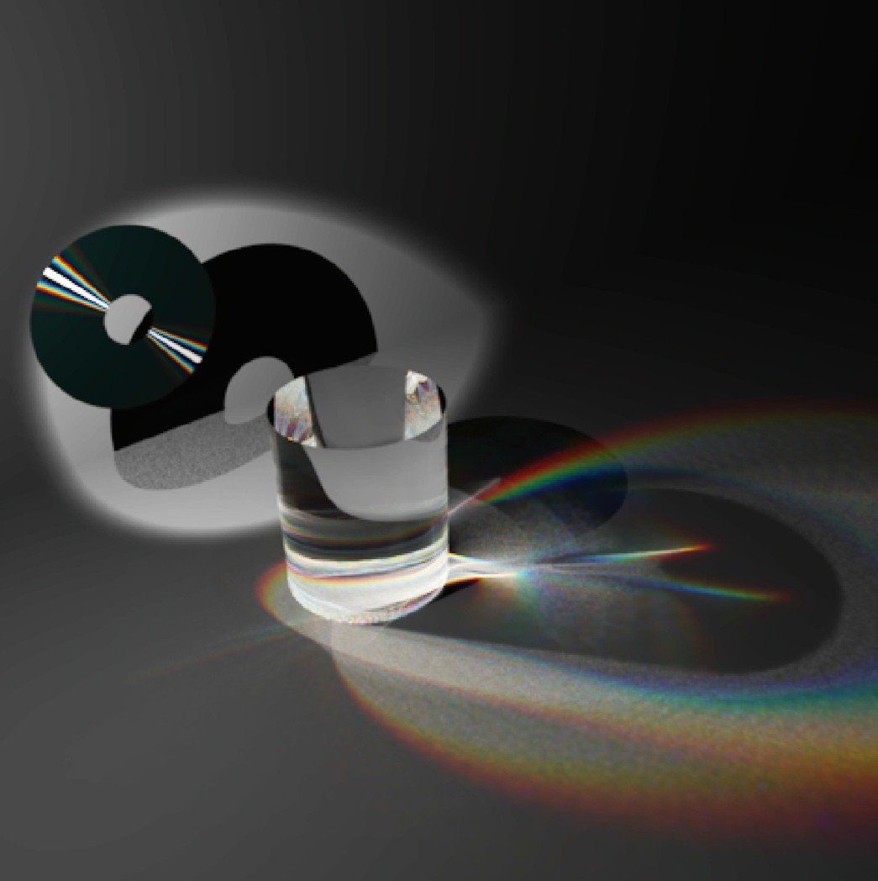
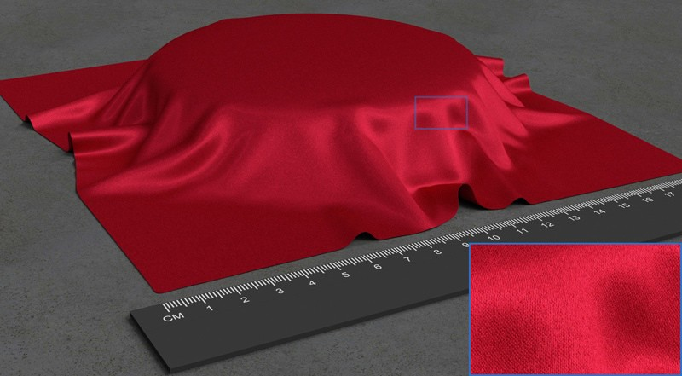
Modeling Surfaces
Building Volumetric Appearance Models of Fabric using Micro CT Imaging
Zhao et al., SIGGRAPH 2011
Ray-Based Reflectance Model for Diﬀraction Cuypers et al., SIGGRAPH 2012

Slide 24
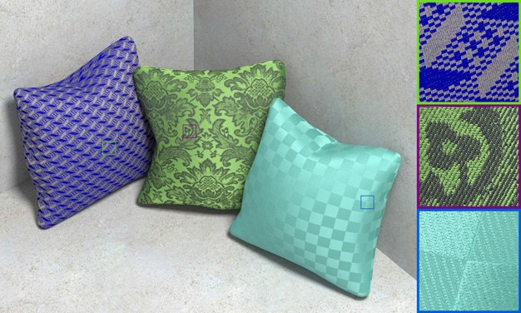
Modeling Surfaces
Structure-aware Synthesis for Predictive Woven Fabric Appearance Zhao et al., SIGGRAPH 2012

Slide 25
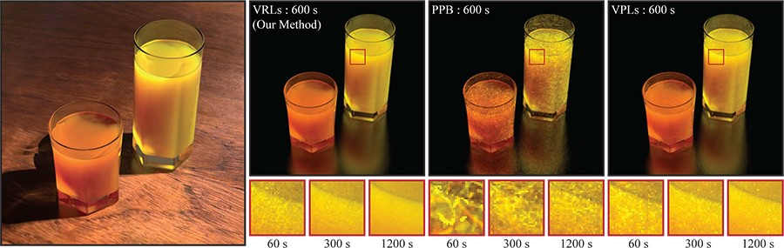
Global Illumination and Light Transport
Virtual Ray Lights for Rendering Scenes with Participating Media Novak et al., SIGGRAPH 2012

Slide 26
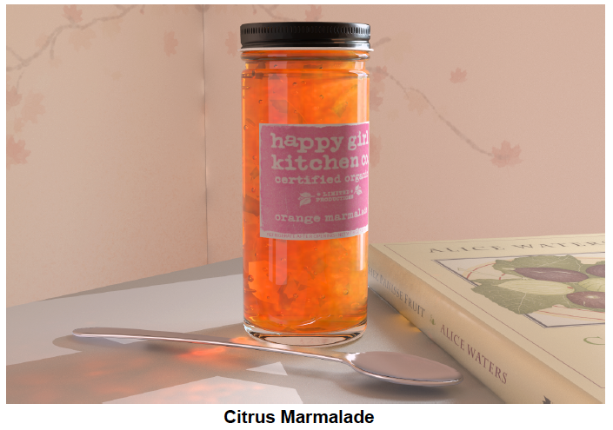

Slide 27
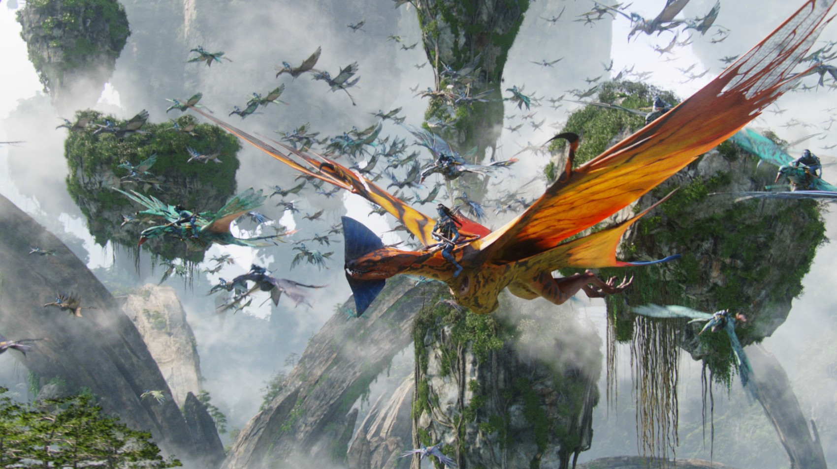
Managing Geometric Complexity
PantaRay: Fast Ray-Traced Occlusion Caching of Massive Scenes Pantaleoni et al., SIGGRAPH 2010

Slide 28
Some Stuff about the Class
Syllabus is on course website:
https://courses.engr.illinois.edu/cs419/index.html
We’ll use Piazza…hopefully a lot

Slide 29
Some Stuff about the Class
Grades probably on usual scale:
97 to 93: A
93 to 90: A-
90 to 87: B+
87 to 83: B
83 to 80: B-
…etc.
won’t be any tighter
Two exams (each 20% of course grade)
Four programming assignments (in total worth 60% of grade)

Slide 30

Some Stuff about the Class
Required text:

Slide 31
Some Stuff about the Class
In addition to the book, we’ll try to cover a few of the following topics
High-Dynamic Range Images
BRDFs and material modeling in greater detail
Photon Mapping
Irradiance Caching
Monte Carlo Methods
Geometric data structures
Texture synthesis
Image-based rendering
Structure from motion
Geometric modeling
Animation
GPU-based Ray-Tracing

Slide 32
Some Stuff about Coding
Use whatever programming languages you want
Use whatever libraries you want
Help each other out on Piazza
You can use other people’s code
You have to document your use
Failure to do so results in a 0 on the assignment
Cannot turn in someone else’s rendered images
Generate your own scenes
Failure to so results in a 0 on the assignment

Slide 33
Some Stuff About Coding
Read the CS 419 Coding Standard PDF on the website
Available soon!
Late submissions lose 10% of original point value per day
Exceptions to the policy can be made in the case of documented illness or other exceptional circumstances. Contact the instructor via e-mail.

Slide 34
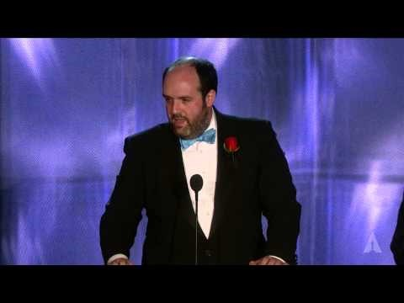
Great Moments in Computer Graphics…

